Slide 1

PART-II
DIGITAL ELECTRONICS
CHAPTER-5: BOOLEAN ALGEBRA AND LOGIC GATES
Reference:
Malvino and Leach, Digital Principles & applications, 7th edition, TMH, 2010
Morris Mano, “Digital design”, Prentice Hall of India, Third Edition.
2
Department of Electronics and Communication Engineering, MIT, Manipal

Slide 2
Boolean Algebra & Logic gates
MODULE -2
LOGIC GATES
2
Department of Electronics and Communication Engineering, MIT, Manipal

Slide 3
Logic Gates
OBJECTIVES
At the end of this module students will be able to :
Describe basic logic gates and the concept of universal logic.
Build a logic circuit for the given Boolean expressions.
Write Boolean expressions for the given logic circuit.
Differentiate combinational and sequential circuits.
2
Department of Electronics and Communication Engineering, MIT, Manipal

Slide 4
Logic Gates
A logic gate is a digital circuit with one or more input signals and only one output signal.
The input and output signals are either HIGH (1) or LOW (0).
Logic gate
2
Department of Electronics and Communication Engineering, MIT, Manipal
Notes:
Input and output signals can be represented as HIGH or LOW, 1 or 0, TRUE or FALSE

Slide 5

Logic Gates
OR Gate:
Table: Truth table for two input OR gate
Input |  | Output
A | B | Y= A+B
0 | 0 | 0
0 | 1 | 1
1 | 0 | 1
1 | 1 | 1

Slide 6
Logic Gates
AND Gate:
Table: Truth table for two input OR gate
Input |  | Output
A | B | Y=A.B
0 | 0 | 0
0 | 1 | 0
1 | 0 | 0
1 | 1 | 1

Slide 7

Logic Gates
Not Gate (Inverter):
=
Truth Table for NOT gate
Input | output
A | Y=
0 | 1
1 | 0

Slide 8
Universal Gates
NAND Gate: The output of a NAND gate is LOW only when all inputs are HIGH and output of the NAND is HIGH if one or more inputs are LOW.
NOR Gate: The output of the NOR gate is HIGH only when all the inputs are LOW.
Universal gates: NAND and NOR gates are called Universal gates.

Slide 10
Universal Gates
NAND gate as Universal gate:
NOT operation:
AND operation:
OR operation:
NOR operation:

Slide 13
Logic Gates
XOR Gate or Exclusive OR gate: output is HIGH only when any one of the input is HIGH. (inequality comparator)
XNOR Gate or Exclusive NOR Gate: complementary of XOR operation.
The output of XNOR gate is High, when all the inputs are identical; otherwise it is low.

Slide 25
Digital circuits
Types of Digital Circuits:
Combinational Digital Circuits
Sequential Digital Circuits
Notes:
Logic circuits whose output at any instant of time is entirely dependent upon the input signals present at that time are known as combinational digital circuits.
The output of the combinational circuit doesn’t depend upon any past input or output. So that the circuit doesn’t possess any memory.
Logic circuits whose output at any instant of time depend not only on the present input but also on the past outputs are called Sequential Circuits. In sequential circuits, the output signals are feedback to the input side. Thus, an output signal is a function of present input signals and a sequence of the past input signal. i.e. the output signals.

Slide 26
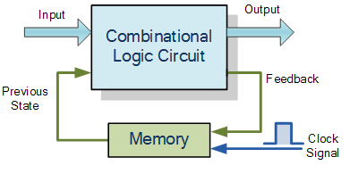
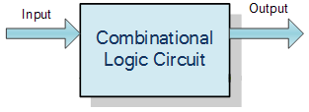
Digital circuits
(a)
(b)
Figure (a) Combinational Circuit (b) Sequential circuit
Notes:
Logic circuits whose output at any instant of time is entirely dependent upon the input signals present at that time are known as combinational digital circuits.
The output of the combinational circuit doesn’t depend upon any past input or output. So that the circuit doesn’t possess any memory.
Logic circuits whose output at any instant of time depend not only on the present input but also on the past outputs are called Sequential Circuits. In sequential circuits, the output signals are feedback to the input side. Thus, an output signal is a function of present input signals and a sequence of the past input signal. i.e. the output signals.

Slide 27
Digital circuits
Elements of combinational logic:
Literal
Ex- X and X’ are both literals. Similarly ABCD’ consists of 4
literals A,B,C and D’.
Product term
Ex- X, XY’, XYZ are the product terms when X,Y,Z are Boolean
variables.
Sum term
Ex- X+Y’, X+Y+Z are the sum terms when X,Y,Z are
Boolean variables.
Notes:
It is a Boolean variable. either in complemented or un-complemented state in the logic expression.
A product term is the logical product (AND) of literals.
A sum term is the logical sum (OR) of literals.

Slide 28
Digital circuits
Continued……..
Sum of products (SOP): Each product term is the logical AND of literals.
Ex: Y+XY’+XYZ
Products of Sums (POS): Each sum term is the logical OR of literals.
Ex: (X+Y’)(X’Y+Z)(X+Y+Z)

Slide 29
Digital circuits
Continued……..
Canonical form: Canonical is defined as “conforming to a general rule”. (Standard form)
All the literals exist either complimented or non complimented form.
Canonical Sum of Products:
Ex: f(A,B,C)= A’B’C+A’BC’+A’BC+ABC’
Canonical Product of Sums:
Ex: f( X,Y)=(X+Y’)(X+Y)(x’+y)

Slide 30
Logic Gates
Continued……..
Minterm: Each product term in the standard (canonical) SOP expression.
Maxterm: Each sum term in the standard (canonical) POS expression

Slide 31
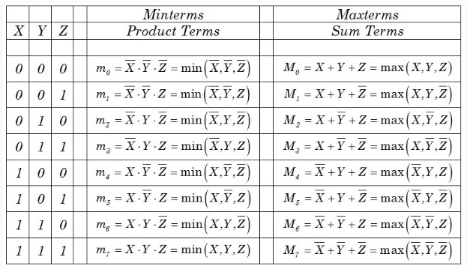
Minterm and Maxterm Notation

Slide 32
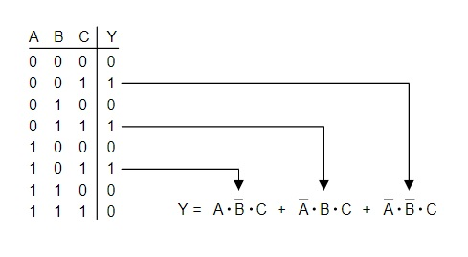
SOP Example

Slide 33
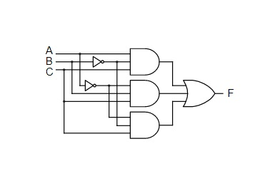
Implementation

Slide 34
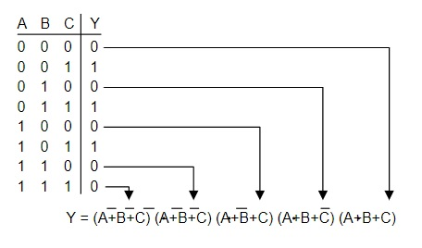
POS Example

Slide 35
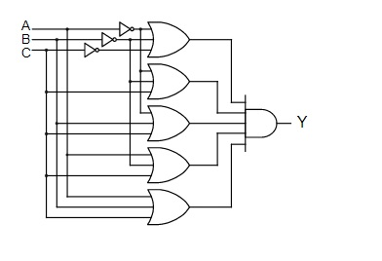
Implementation

Slide 36
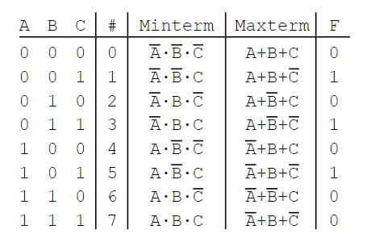
Write the SOP & POS representation

Slide 37
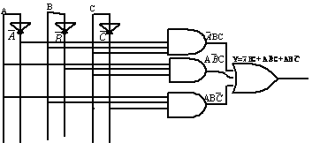
Building logic circuits using Boolean expression
Examples of combinational circuits
Draw the logic circuit for the Boolean expression. Y= A’BC+AB’ C+ABC’.
( Do the reverse process also)

Slide 38
Combinational circuits
Half adder circuit
Input |  | Output
A | B | Sum | Carry
0 | 0 | 0 | 0
0 | 1 | 1 | 0
1 | 0 | 1 | 0
1 | 1 | 0 | 1

Slide 39
Continued…….
Sum= A’B+AB’ =A XOR B
Carry= A.B

Slide 40
Self test
Show that NOR is a universal gate.
Draw the logic circuit for the Boolean expression. Y= BC+A’ C+AB’C.
Implement the half adder circuit using XOR gates.
Implement the full adder circuit using logic gates.

Slide 41
Summary
Logic gates are fundamental building blocks of digital systems
The basic set of logic gates are AND, OR and NOT and this set is called Universal set.
NAND and NOR are called Universal gates.
Inputs and outputs of logic gates can occur in two levels. These two levels are termed as HIGH and LOW, or TRUE and FALSE, or ON and OFF, or simply 1 or 0.
Logic circuits whose output at any instant of time is entirely dependent upon the input signals present at that time are known as combinational digital circuits.
Logic circuits whose output at any instant of time depend, not only on the present input but also on the past outputs are called Sequential Circuits.

Slide 42
Exercise:
Draw the logic circuit for the Boolean expression. Y= BC+A’ C+AB’C.
Show that AB+(A+B) is equivalent to A ʘ B. Also construct the corresponding logic diagrams.
The most suitable gate to check whether the number of 1s in a digital word is even or odd is -----------
a)X-OR b) NAND c) NOR d) AND, OR and NOT
Realize NOR and NAND gate using discrete components.
Implement Full Subtractor using Basic gates.
Implement full adder using two half adders.

Slide 43
Module-3
KARNAUGH MAP (K – MAP)

Slide 44
KARNAUGH MAP (K – MAP)
OBJECTIVES
At the end of this module students will be able to :
Explain the standard form of Boolean expressions.
Apply the K-map for Boolean expression simplification and design of logic circuits.

Slide 45
KARNAUGH MAP (K – MAP)
Karnaugh map (k – map) method of simplifying the Boolean expressions:
Boolean expression can be expressed in sum of product (SOP) form or product of sum (POS) form.
Boolean expression in SOP form:
Y = AB’C + ABC + A’BC
Each of the product terms in the standard SOP form is called a minterm.
Boolean expression in POS form:
Y = (A + B + C’) (A’ + B + C) (A + B + C)
Each sum term in the standard POS form is called a maxterm.

Slide 46
Steps to convert SOP to canonical SOP:
Find the missing literal in each product term.
AND each product term having missing literals with terms by ORing the literal and its complement.
Expand the terms and reduce the expression by removing repeated terms.
Ex1: F(A,B,C) = AC+AB+BC
= A (B+B’)C+AB(C+C’)+(A+A’)BC
= AB’C+ABC’+A’BC+ABC

Slide 47
Steps to convert POS to canonical POS:
Find the missing literal in each sum term.
OR each sum term having missing literals with terms by ANDing the literal and its complement.
Expand the terms and reduce the expression by removing repeated terms.
Ex2: F (A, B, C) = (A+B)(B+C)(C+A)
Notes:
The canonical SOP and Canonical POS representation of a Boolean function are complementary. The numbers which are existing in SOP representation do not appear in POS representation. Similarly all the numbers which exist in POS representation do not appear in SOP representation. To convert from one canonical form to other canonical form, the symbols Σ and п will be interchanged and the list of numbers will be present in new form which is actually missing from original form.

Slide 48
Self test
1. Determine the Boolean function of the truth table in canonical S0P form and simplify the expression.
Inputs |  |  | Output
A | B | C | Y
0 | 0 | 0 | 1
0 | 0 | 1 | 1
0 | 1 | 0 | 0
0 | 1 | 1 | 0
1 | 0 | 0 | 1
1 | 0 | 1 | 1
1 | 1 | 0 | 0
1 | 1 | 1 | 0

Slide 49
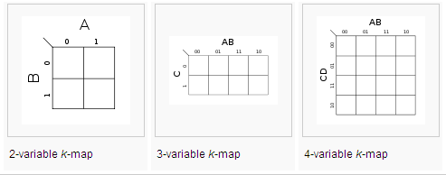
KARNAUGH MAP (K – MAP)
Introduction
Structure of a K - map :
Two variable K – map has 2² = 4 cells
Three variable K-map has 2³ = 8 cells
Four variable K-map has 2⁴ = 16 cells.

Slide 50
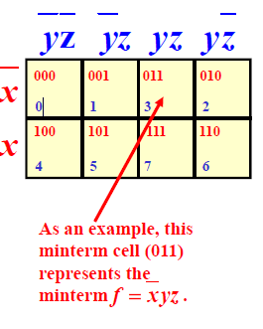
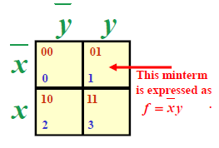
KARNAUGH MAP (K – MAP)
2-Variable K-MAP
3-Variable K-MAP
Notes:
When moving horizontally or vertically, only one variable changes between adjacent squares, never 2. This property of K-map is unique and accounts for its unusual numbering system.

Slide 51
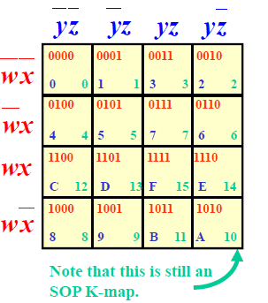
KARNAUGH MAP (K – MAP)
4-Variable K-MAP
Notes:
In all K-maps, left and right edges are a common edge, while top and bottom edges are also the same edge. Thus top and bottom rows are adjacent, as are the left and right columns.
On all K-maps, right and left edges are a common edge, while the top and bottom edges are also the same edge. Thus top and bottom rows are adjacent, as are left and right columns.

Slide 52
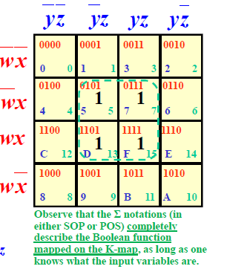

KARNAUGH MAP (K – MAP)
Simplification of Boolean expressions in SOP form:
Place logical 1s in the appropriate cells.
2. Two or Four or Eight adjacent logical ‘1s’ can be grouped
together.
Example

Slide 53
KARNAUGH MAP (K – MAP)
PROBLEM : Reduce the following Boolean expression using K-map:
f = AB + AB’C + A’BC’ + BC’
Soln. The given Boolean expression is not in SOP form.
f = AB(C + C’) + AB’C + A’BC’ + BC’(A +A’)
= ABC + ABC’ + AB’C + A’BC’ + ABC’ + A’BC’
= ABC + ABC’ + AB’C + A’BC’
= Ʃm( 7, 6, 5, 2 )
Ans. f = AC + BC’
Simplify using 3-variable K-map

Slide 54
KARNAUGH MAP (K – MAP)
Self test
Problem 1 Reduce the Boolean expression
f = Ʃm (0, 2, 3, 4, 5, 6) using K-map and implement it in AOI logic.
Ans: f = C’ + AB’ + A’B
Problem 2 Reduce the expression f= A’B’+A’B+AB using mapping
Ans: f=A’+B

Slide 55
KARNAUGH MAP (K – MAP)
Don’t care terms
The combinations for which the values of the expression are not specified are called don’t care combinations.
The don’t care terms are denoted by d or X.
Ex1: Simplify the following Boolean expression using K Map.
F(A,B,C) = Σm(3, 4) + d(2,5,6)
BC A | 00 01 11 10
0 1 | 0 | 0 | 1 | X
 | 1 | X | 0 | X
F = AB’ + A’B

Slide 56
KARNAUGH MAP (K – MAP)
Summary
The K-map is a chart or a graph, composed of an arrangement of adjacent cells, each representing a particular combination of variables in sum of product form.
It is a means of showing the relationship between the logic inputs and desired output.
K-map is limited to 6 variables.
Any Boolean expression can be expressed in a standard or canonical or expanded sum (OR) of products (AND) form –SOP form—or in a standard or canonical or expanded product (AND) of sums (OR) form – POS form.

Slide 57
Exercise:
1.Consider the truth table of a function. Transfer the outputs to the K map and write the Boolean expression.
A | B | Y
0 | 0 | 0
0 | 1 | 1
1 | 0 | 1
1 | 1 | 1
2. Simplify the following Boolean expressions using K maps.
F = Σm(0,2,4,6)
F = Σm(0,2,4,6) + d( 5,7).

